Slide 1



VigilSiddhi IntelliSub
Local-Only AI Subtitle Generation and Refinement System
Offline, Privacy-Focused Speech-to-Subtitle Solution with Continuous Learning
Professional Subtitle Generation Platform
VigilSiddhi IntelliSub

Slide 2

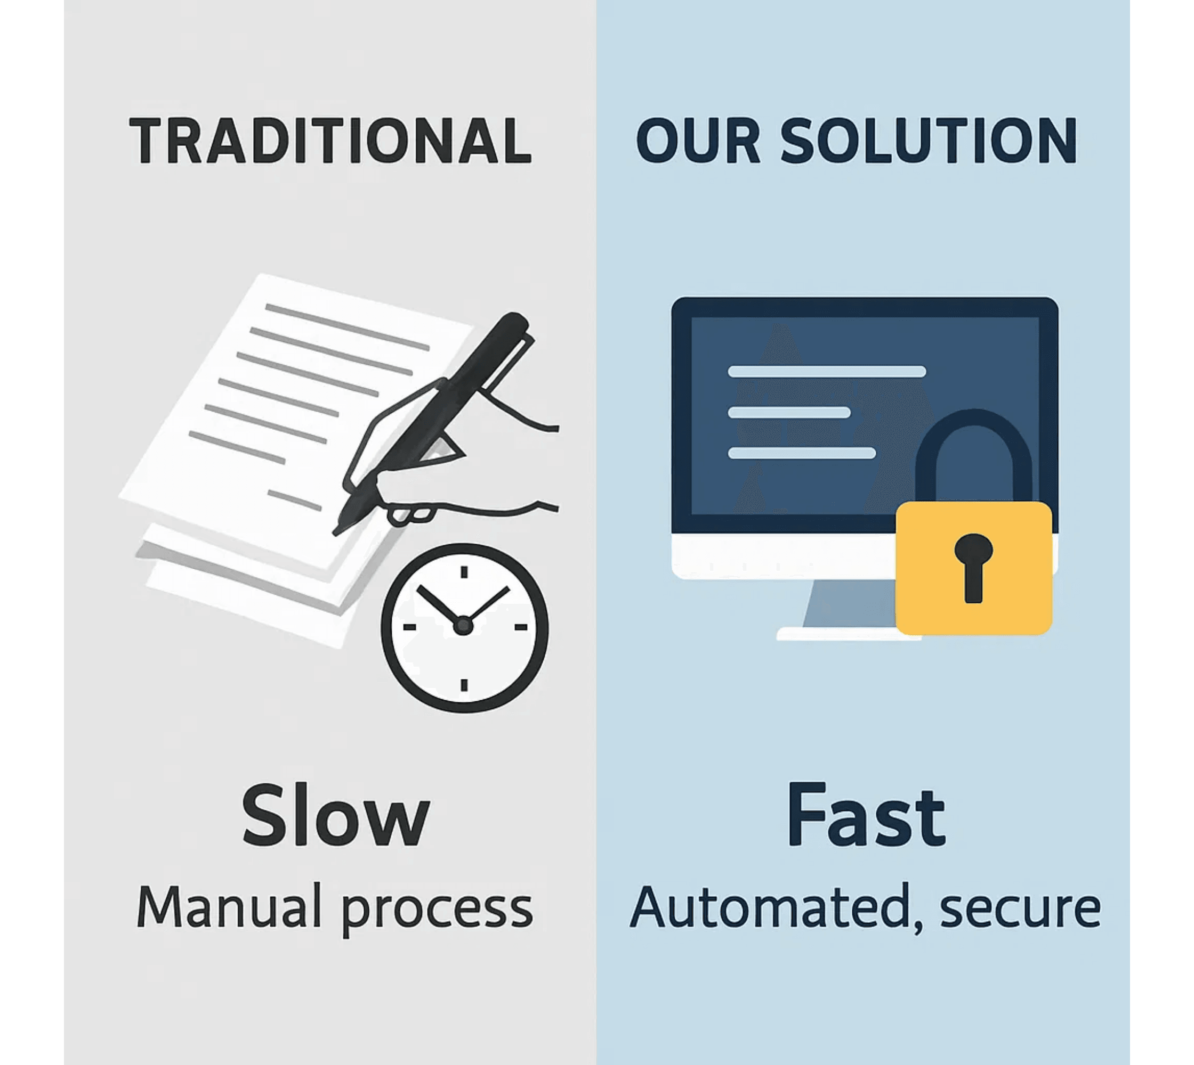
Challenges with Current Subtitle Workflows
Manual subtitling is slow and error-prone
•
Cloud ASR tools raise privacy and cost concerns
•
Repetitive correction effort across episodes wastes resources
•
Lack of domain vocabulary tuning limits accuracy
•
VigilSiddhi IntelliSub

Slide 3

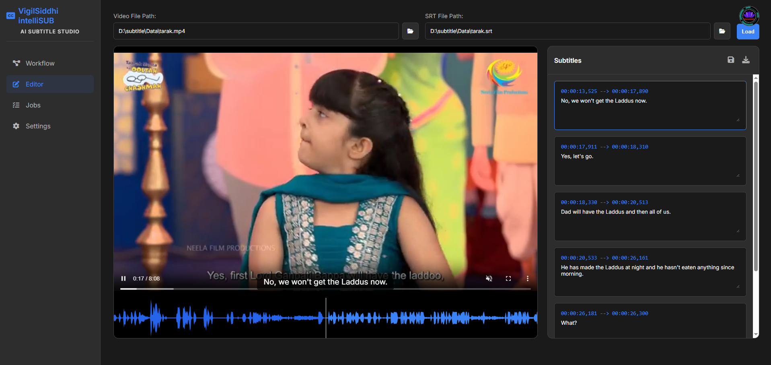



Local AI Subtitle Generation Platform
Our end-to-end system operates fully offline on CPU or GPU, generating timed, readable, professional subtitles with an editable Web UI for human review.
Fully Offline
Works on CPU or GPU without internet or cloud dependencies
Professional Subtitles
Generates timed, readable subtitles with millisecond precision
Editable Web UI
Intuitive interface for human review and manual adjustments
Multi-Format Export
Supports SRT, STL, VTT formats
VigilSiddhi IntelliSub

Slide 4

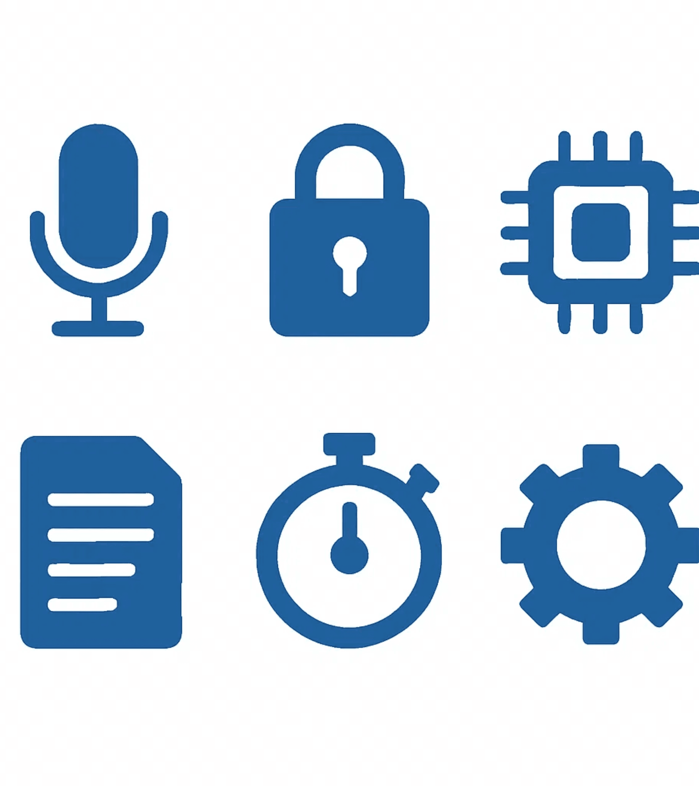




Key Features at a Glance
Local Speech Model
Whisper-based ASR optimized for CPU and GPU processing without cloud dependencies
Professional Subtitle Output
Supports SRT, VTT, STL formats for industry compatibility
Timing Precision
Millisecond-level accuracy with no overlaps and smart line breaking (CPS ≤ 17)
Editable Web UI
Waveform visualization, drag-to-adjust timing, and keyboard shortcuts for efficient editing
VigilSiddhi IntelliSub

Slide 5

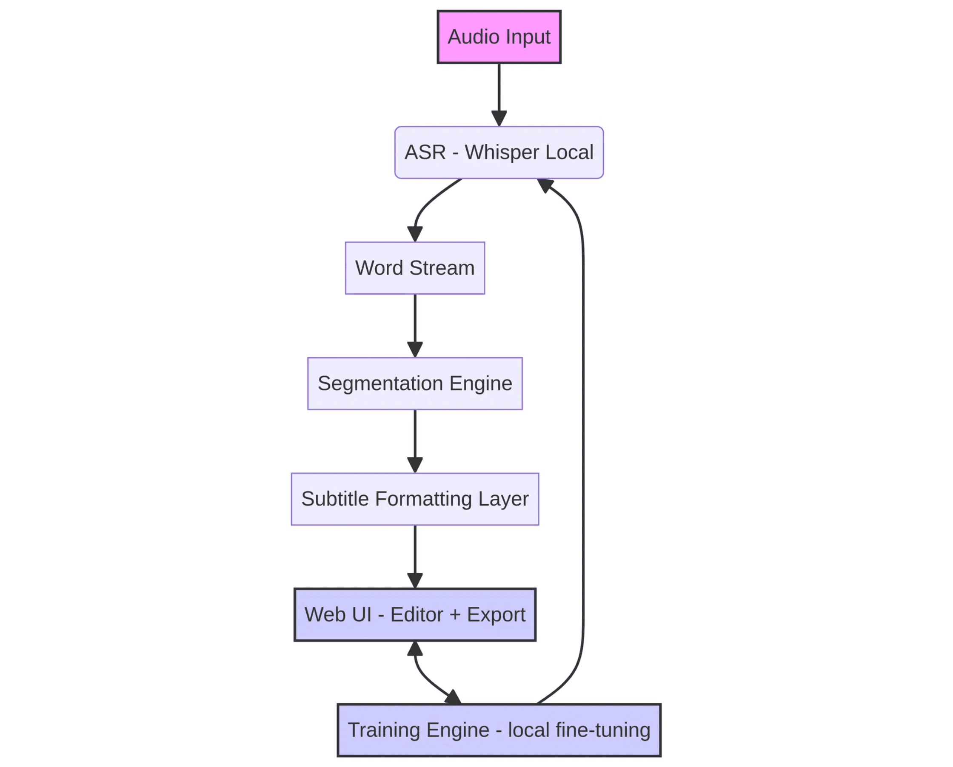




Modular Architecture — Built for Flexibility
The system follows a modular design where each component is isolated, allowing models and UI components to be replaced or upgraded without rewriting the core system.
Audio Input
Accepts audio from various sources and formats
ASR Processing
Whisper-based speech recognition generates word stream
Segmentation & Formatting
Processes timing and formats subtitles for display
Web UI & Training
Bidirectional learning from human corrections improves accuracy
VigilSiddhi IntelliSub

Slide 6






Proven Open-Source Technologies
The platform leverages industry-proven technologies ensuring reliability, performance, and maintainability across all system layers.
Speech Recognition
Faster-Whisper and CTranslate2 for optimized local ASR processing
Web UI & Segmentation
FastAPI, Vanilla JS, WaveSurfer, and Python custom timing logic
Training Engine
PyTorch and scikit-learn for continuous model improvement
Storage & Export
SQLite for project storage and pure Python exporters for all formats
VigilSiddhi IntelliSub

Slide 7

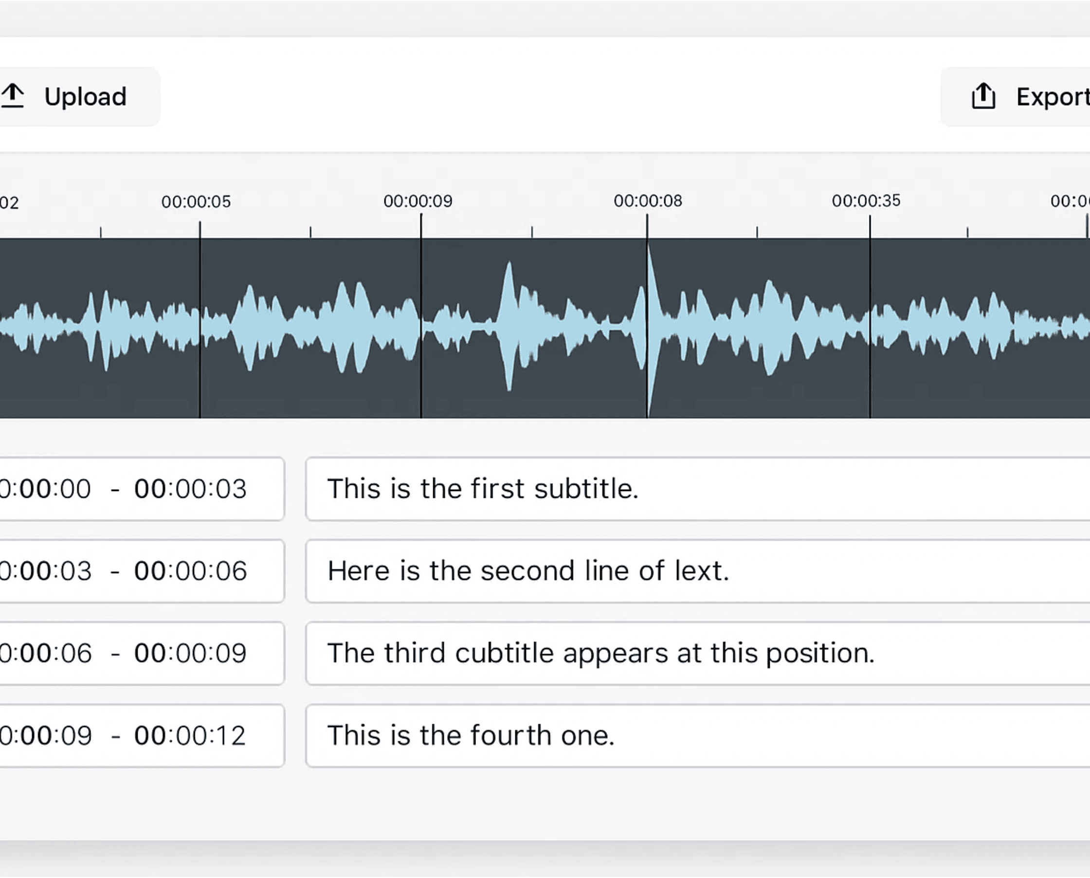




Intuitive Subtitle Editor
The web-based editor simplifies subtitle review: upload audio, generate cues, edit text, adjust timing, and export in your preferred format—all with full control.
Upload Audio
Waveform auto-renders instantly for visual reference
Generate Subtitles
Click "Transcribe" to automatically generate subtitle cues
Edit & Adjust
Edit text and drag timing bars to synchronize perfectly
Keyboard Shortcuts
Space for play/pause, arrows for seeking—fast editing
Save & Export
Export to SRT, VTT, STL, and other industry formats
VigilSiddhi IntelliSub

Slide 8






Day 1 Accuracy Benchmarks
Word Error Rate (WER)
English: 7–10% | Regional Accents: 15–18%
Character Error Rate (CER)
English: 5% | Regional Accents: 10%
Timing Error (Average)
English: ±0.15s | Regional Accents: ±0.25s
CPS Compliance
Over 98% correct timing segments with no overlaps
VigilSiddhi IntelliSub

Slide 9

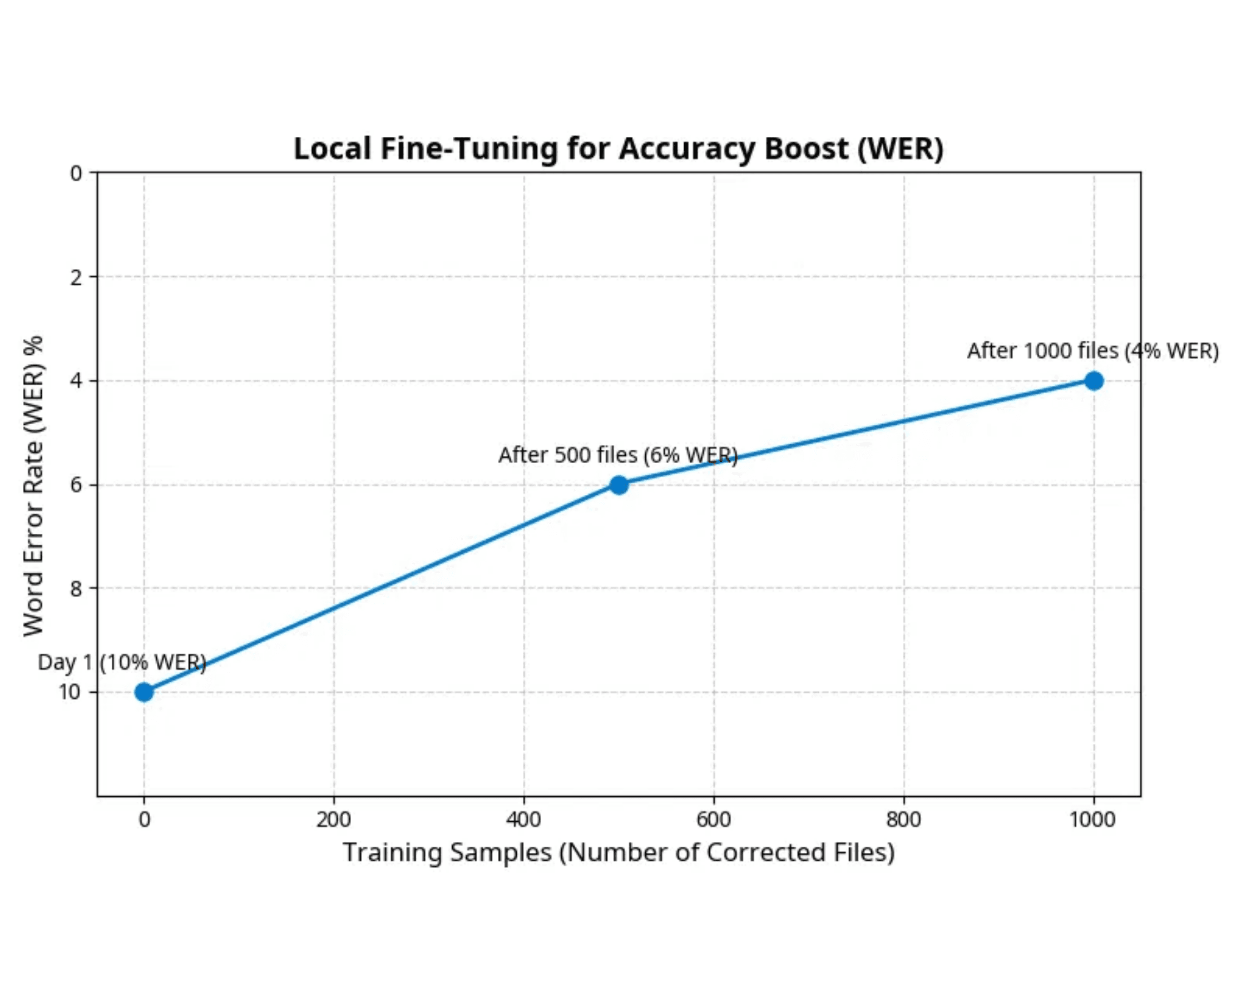


Local Fine-Tuning for Accuracy Boost
The system employs triplet learning using (Audio, Machine Subtitle, Human-Corrected Subtitle) tuples to continuously improve accuracy without cloud retraining.
Triplet Learning
Uses audio, machine-generated, and human-corrected subtitles as training tuples
Dual Model Improvement
Punctuation + Casing Model (BiLSTM) and Timing Correction Regressor evolve together
Local Adaptation
Updates reload locally anytime—no cloud dependency, no vendor lock-in
VigilSiddhi IntelliSub

Slide 10

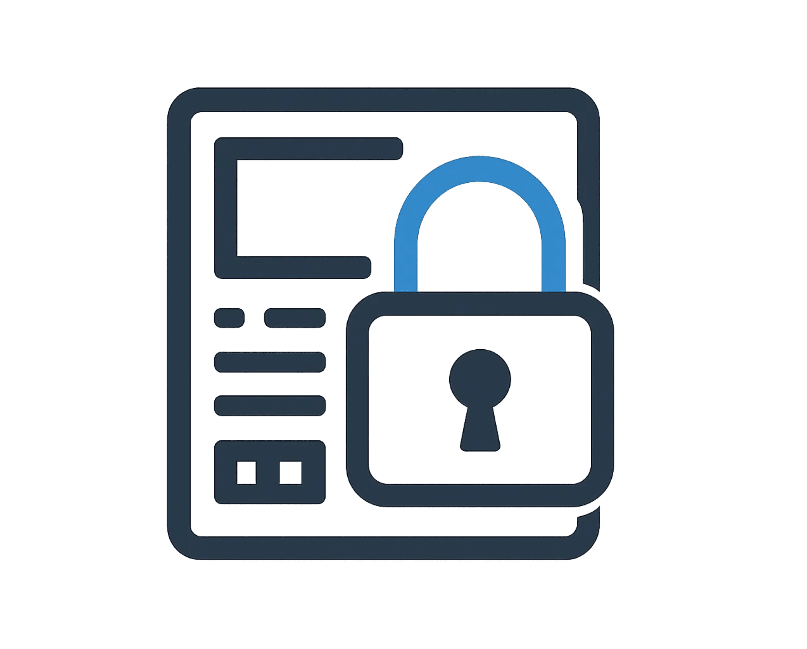



100% Offline — Enterprise-Grade Privacy
The platform ensures complete data privacy with no internet or API calls required. All processing uses local SQLite and filesystem storage, ensuring audio never leaves the workstation.
No Internet Required
Zero cloud dependencies or API calls—complete offline operation
Local Storage Only
SQLite and filesystem storage keep all data on your workstation
Audio Protection
Audio content never leaves the workstation—ideal for confidential use
Isolated Environments
Supports isolated and offline environments for maximum security
VigilSiddhi IntelliSub

Slide 11






Built-in Quality Metrics
WER / CER
Word and Character Error Rates measure text accuracy of the generated subtitles
Timing Error
Assesses subtitle-to-speech alignment precision and synchronization quality
Overlap Violations
Checks subtitle spacing integrity to ensure no overlapping cues
CPS Threshold
Controls readability by monitoring characters-per-second display rate
VigilSiddhi IntelliSub

Slide 12

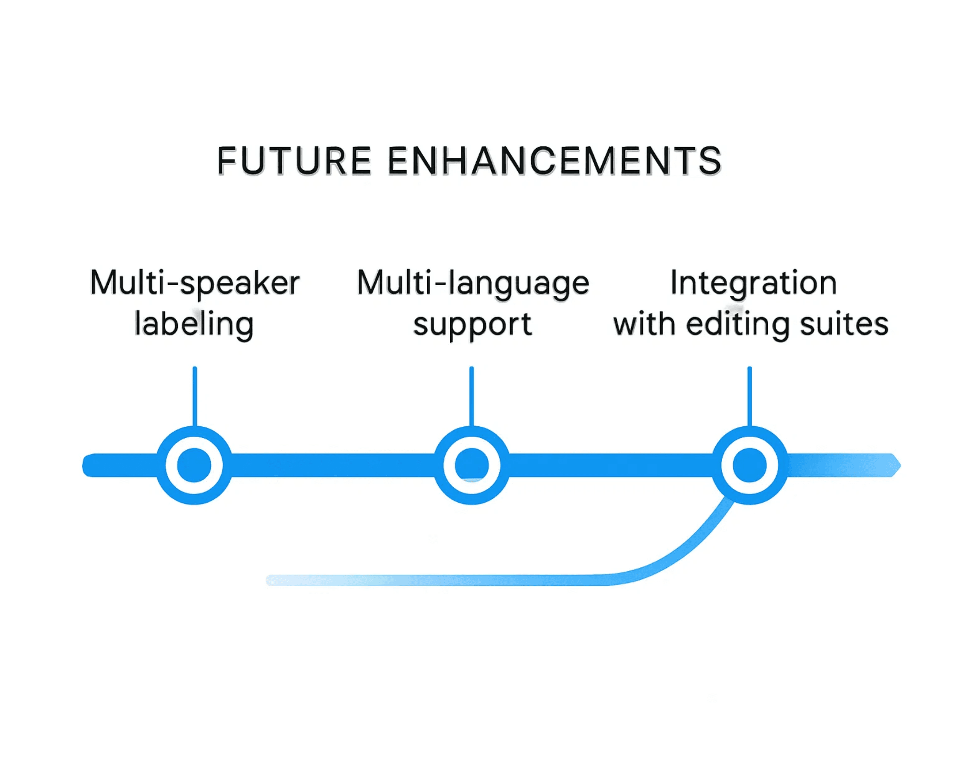






What's Next
The product roadmap includes exciting enhancements that will expand system capabilities and accessibility for broader adoption.
Multi-speaker Labeling
Local diarization for speaker identification
Domain Vocabulary
Auto-adaptation for specialized terminology
Multi-language Support
Marathi, Telugu, and additional languages
GPU Acceleration
Performance profiles for enhanced processing
Editing Suite Integration
Premiere, GV Tools, and other platforms
Docker Packaging
Streamlined deployment and distribution
VigilSiddhi IntelliSub

Slide 13

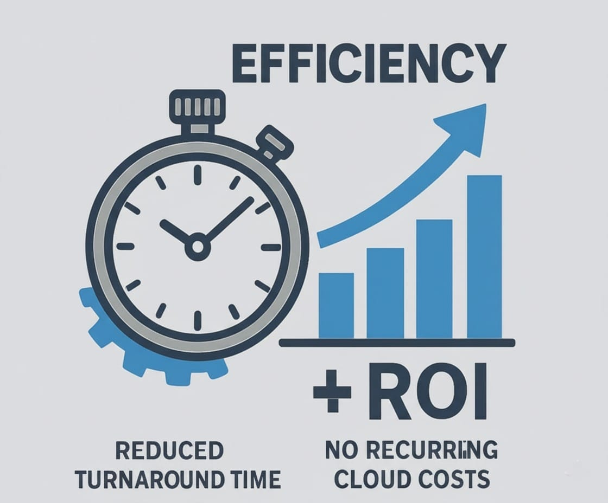




Value to Our Organization
The system delivers substantial organizational benefits, positioning it as a strategic asset for production efficiency and data protection.
Reduce Turnaround Time
Subtitle generation accelerated through automation
Zero Recurring Costs
Eliminate expensive cloud ASR subscriptions and API charges
Data Privacy Assurance
Ensure full confidentiality for sensitive client and studio content
Scalable Deployment
Deploy on any desktop or edge system without infrastructure constraints
Continuous Improvement
Improve over time without vendor lock-in or external dependencies
VigilSiddhi IntelliSub

Slide 14

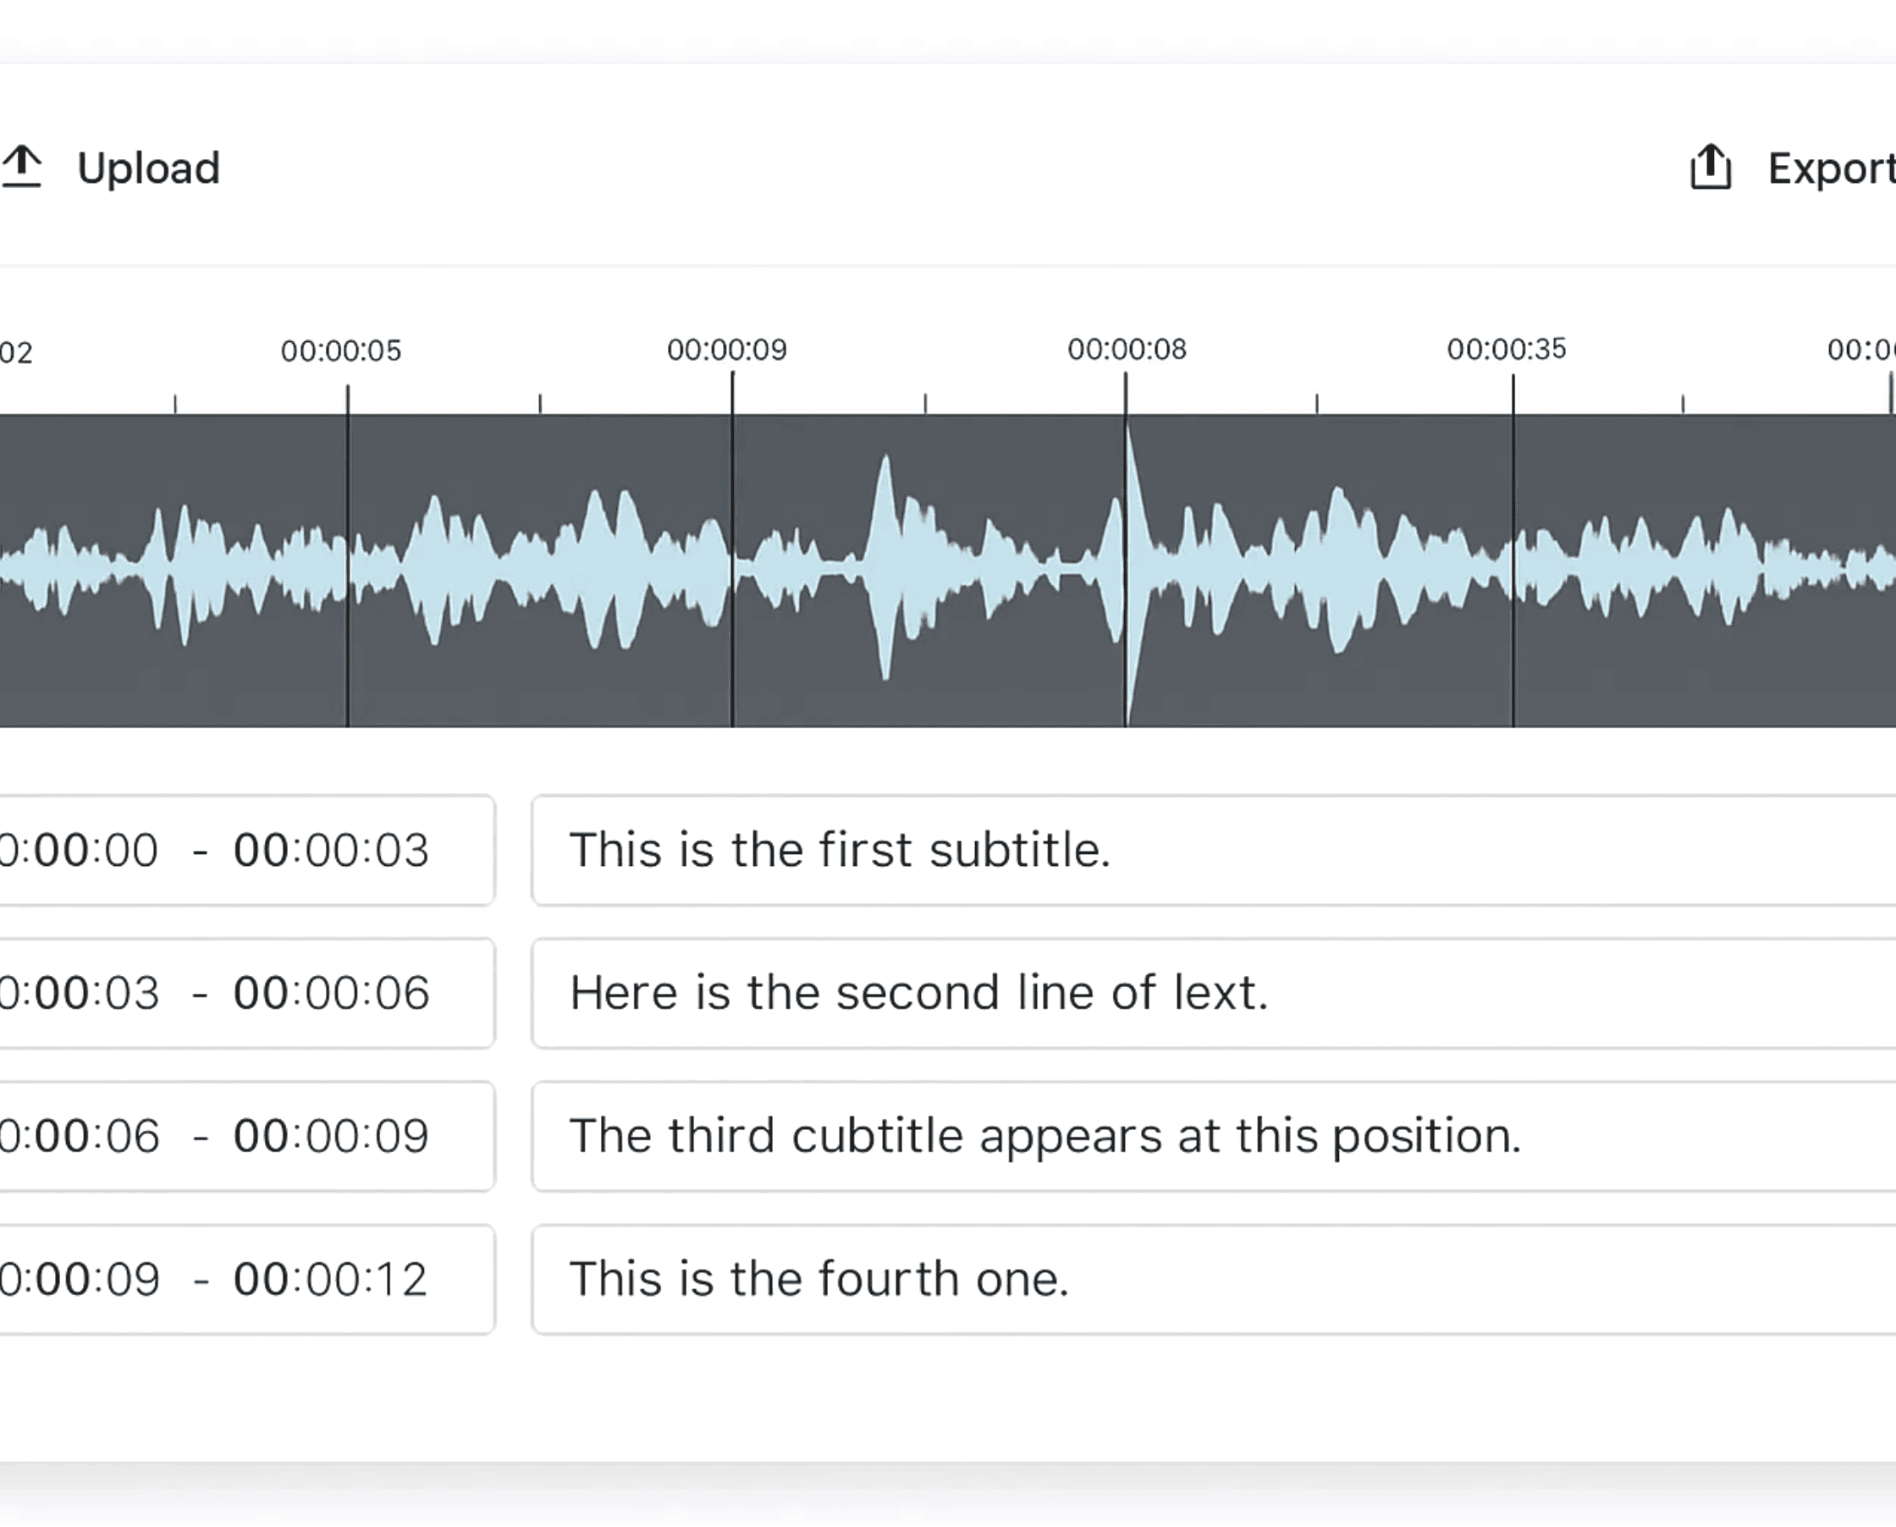


Live Demonstration
The demonstration showcases the system's practical capabilities: a live UI display featuring the waveform with synchronized subtitle blocks, interactive adjustments, and instant export functionality.
Waveform Display
Audio waveform with synchronized subtitle blocks for visual alignment
Drag-and-Drop Timing
Interactive timing bar adjustments for precise subtitle synchronization
Instant Export
One-click export to SRT, VTT, STL, and other industry-standard formats
VigilSiddhi IntelliSub

Slide 15




Local AI Subtitling — Smart, Private, Evolving
The system is ready for internal pilot deployment and expansion to all production units, with proven accuracy, privacy, and scalability. This represents a strategic opportunity to transform our subtitle workflow while maintaining complete data control.
Proven Accuracy: 7–10% WER baseline, improving with continuous learning
Complete Privacy: 100% offline operation, no cloud dependency
Scalable Deployment: Works on any desktop or edge system
Q & A
"Next Step: Approve internal rollout for pilot usage (6-8 weeks)"
VigilSiddhi IntelliSub

